Slide 1
Compression III

Slide 2
LZW Compression
Trace of table insertions and output codes for the input string:
SEE SPOT RUN. RUN SPOT RUN. RUN RUN SPOT. RUN RUN RUN.
Initially: insert codes 0..255 (all ASCII characters) into the dictionary for each possible 8-bit sequence. For strings, this amounts to the values in the extended ASCII sequence.

Slide 3
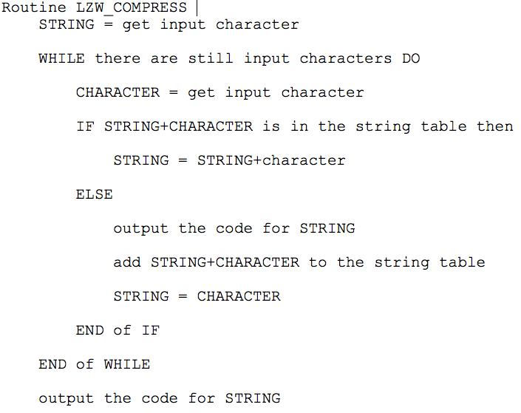
LZW Compress

Slide 4


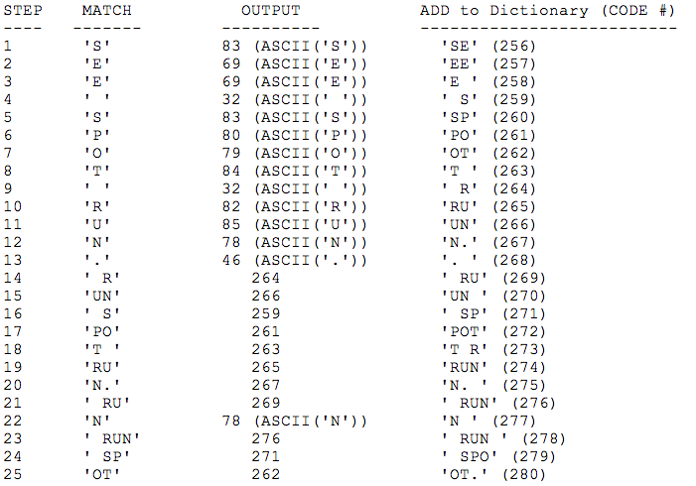
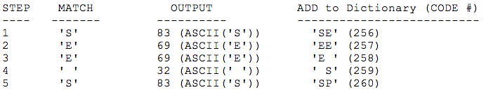
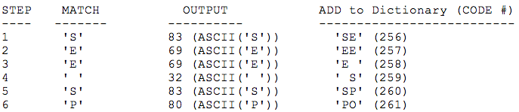
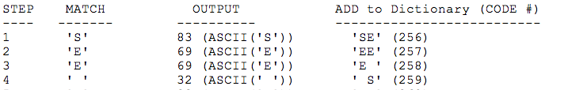
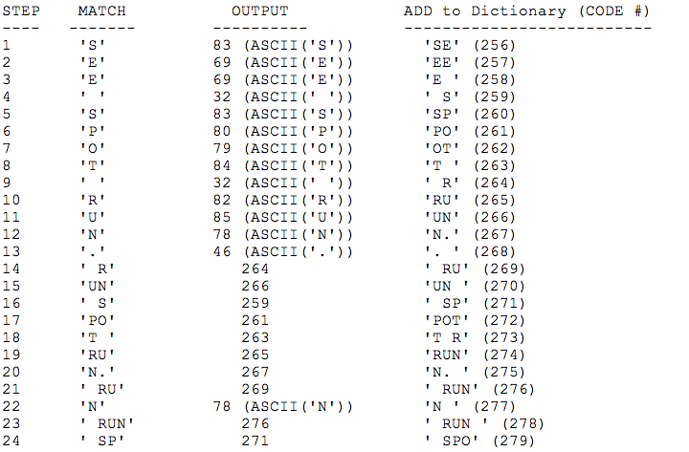
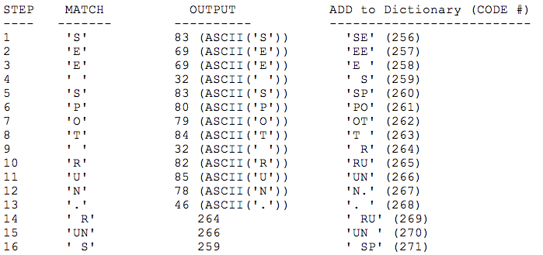
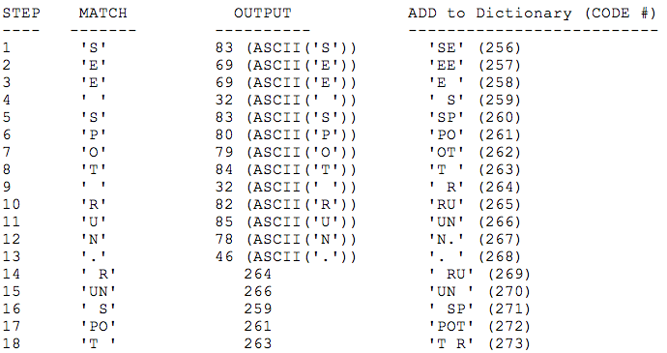
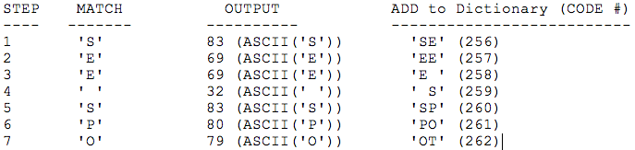
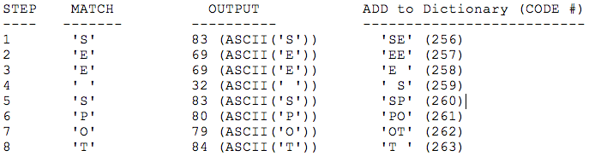
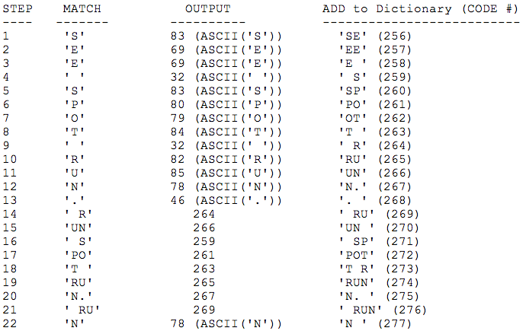
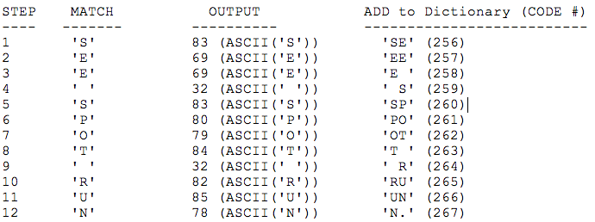
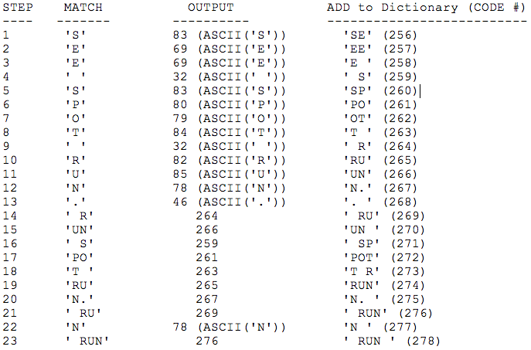
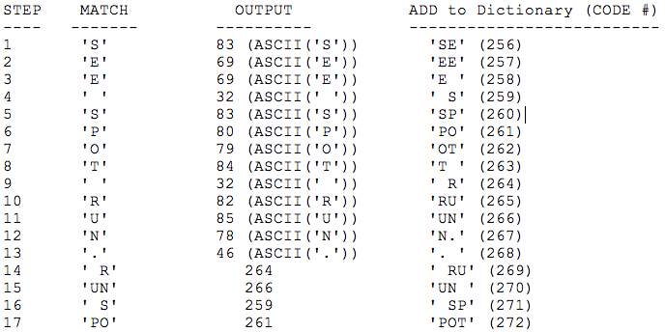
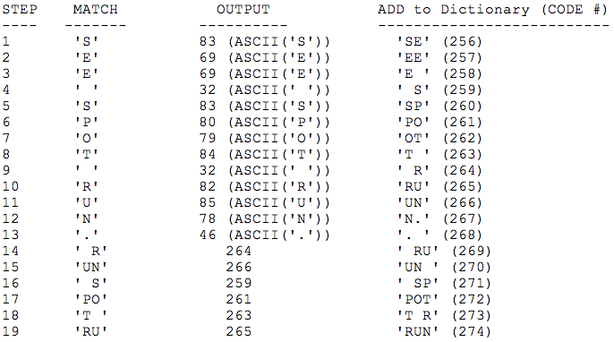
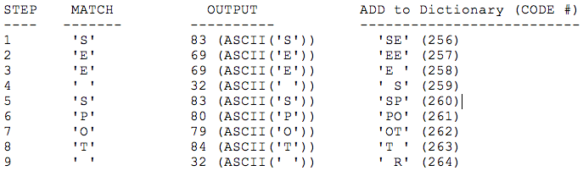
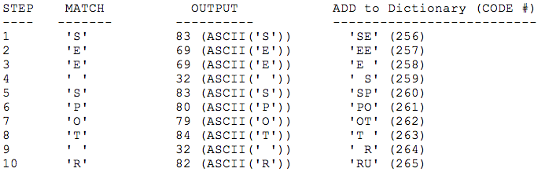
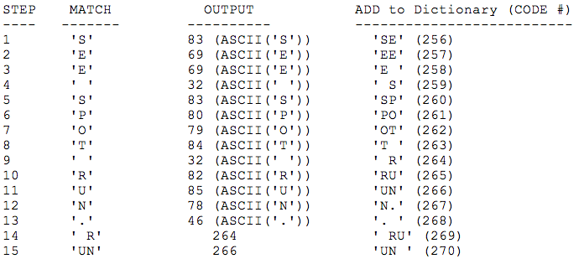
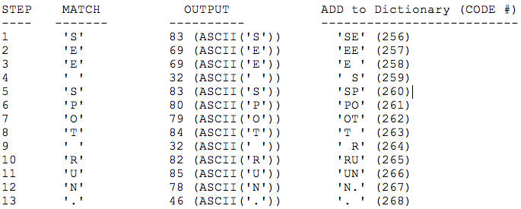
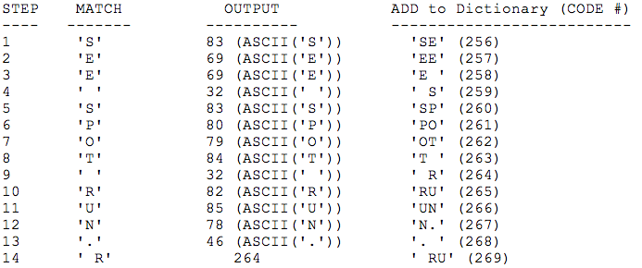
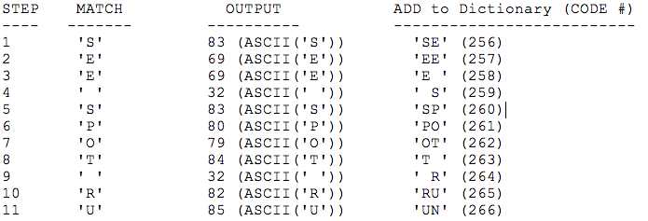
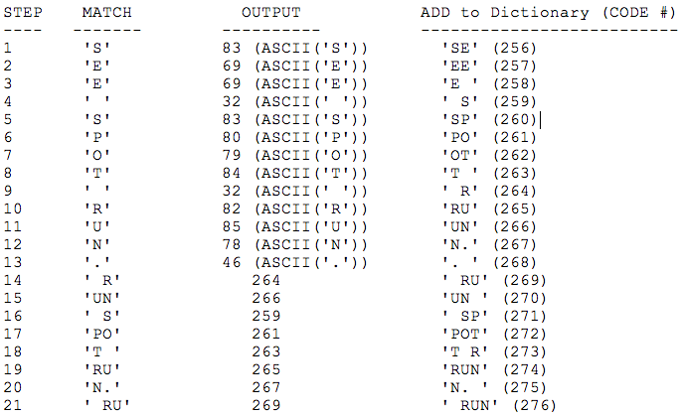
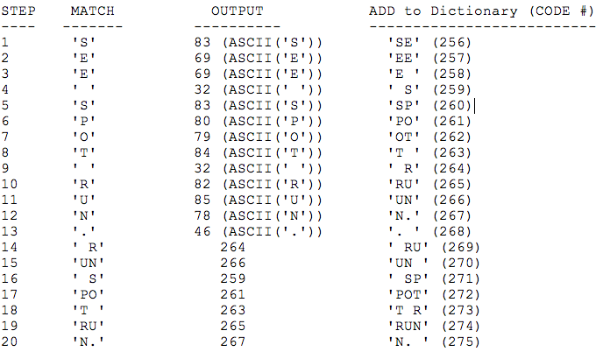

Slide 5
LZW Decompression
Trace of table insertions and output codes for the input string:
83 69 69 32 83 80 79 84 3282 85 78 46 264 266 269 …
Initially: insert codes 0..255 (all ASCII characters) into the dictionary for each possible 8-bit sequence. For strings, this amounts to the values in the extended ASCII sequence.

Slide 6
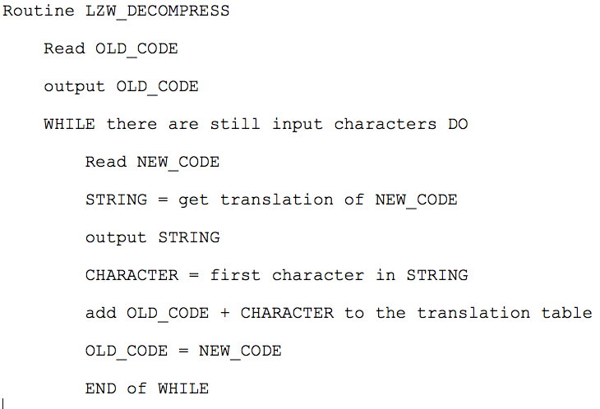
LZW Decompress

Slide 7
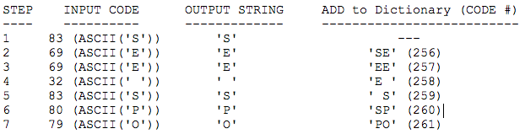


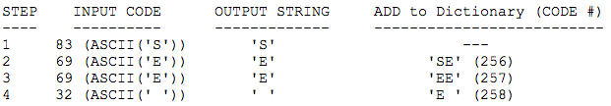
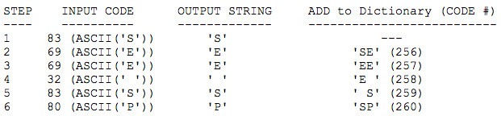
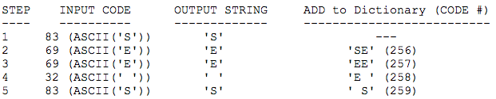
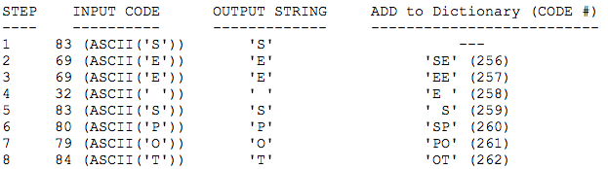
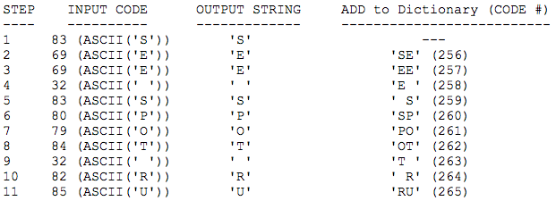
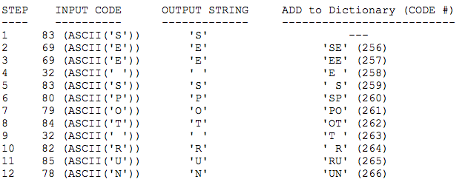
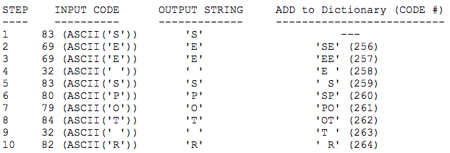
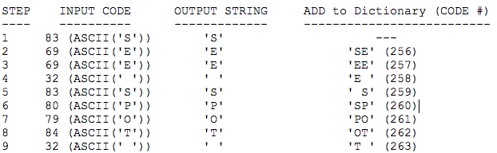
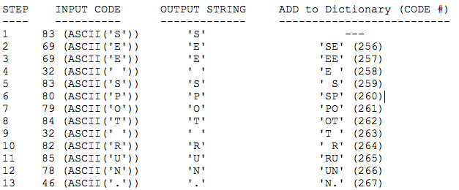
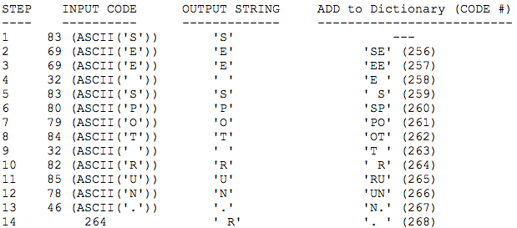
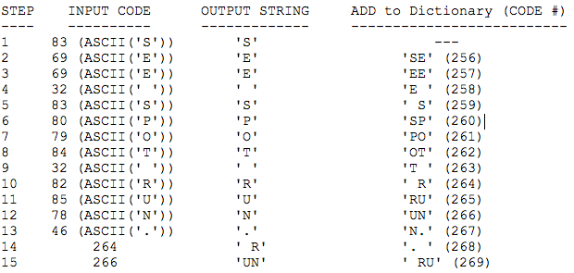
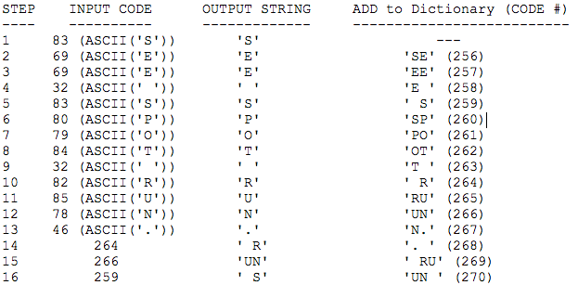
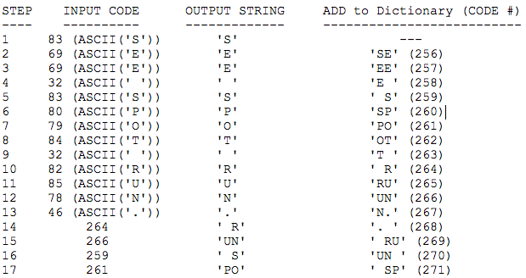
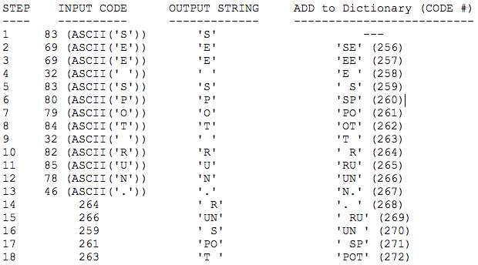
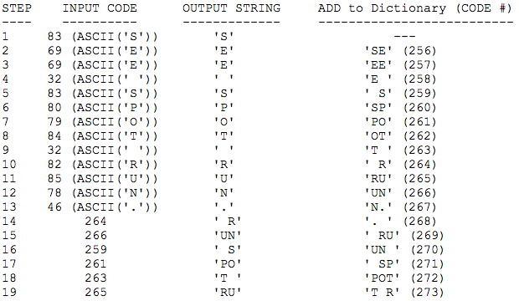
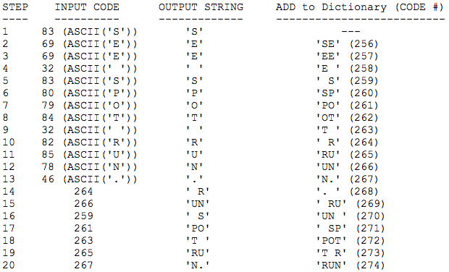

Slide 8
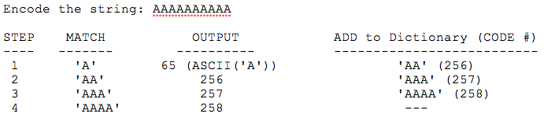

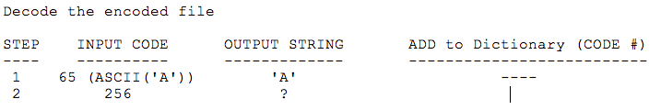
Problem with Decompression

Slide 9
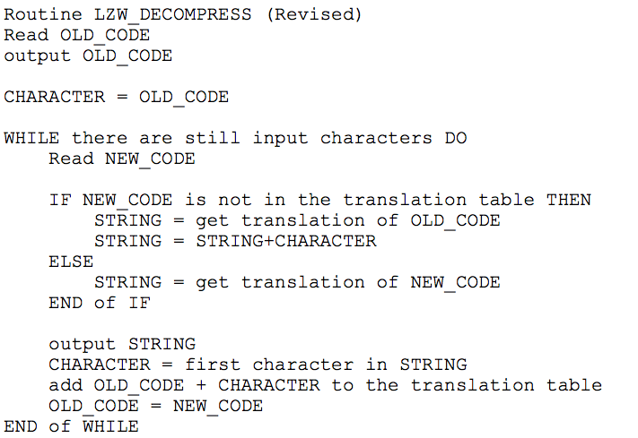
Revised Decompression

Slide 10
Improving Compression
The move-to-front (or MTF) transform is an encoding of data (typically a stream of bytes) designed to improve the performance of lossless data compression techniques.
When efficiently implemented, it is fast enough that its benefits usually justify including it as an extra step in data compression algorithms like Huffman or LZW.

Slide 11
Improving Compression
The main idea of move-to-front encoding is to maintain an ordered list of legal symbols, and repeatedly read in symbols from the input message, print out the position in which that symbol appears, and move that symbol to the front of the list. Each byte value is encoded by its index in the list, which changes over the course of the algorithm.
The list is initially in order by byte value (0, 1, 2, 3, ..., 255). Therefore, the first byte is always encoded by its own value. However, after encoding a byte, that value is moved to the front of the list before continuing to the next byte.
The idea to is put the most frequently occurring bytes at the front of list while the less frequently seen are move deeper in the list.

Slide 12
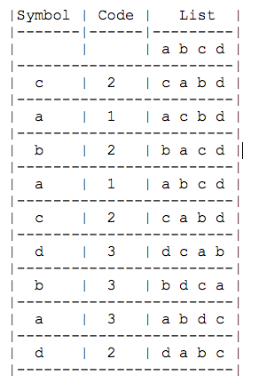
Improving Compression
Let's use the symbols a, b, c, d to represent the different kinds of bytes encountered. Suppose we are processing the stream: cabacdbad.
0 1 2 3
So the input stream: "cabacdbad" is encoded as: "2 1 2 1 2 3 3 3 2"
(note: four 2s, three 3s, and two 1s : Huffman)
or look at the seen patterns "21", "12", "212", ..., : LZW).

Slide 13
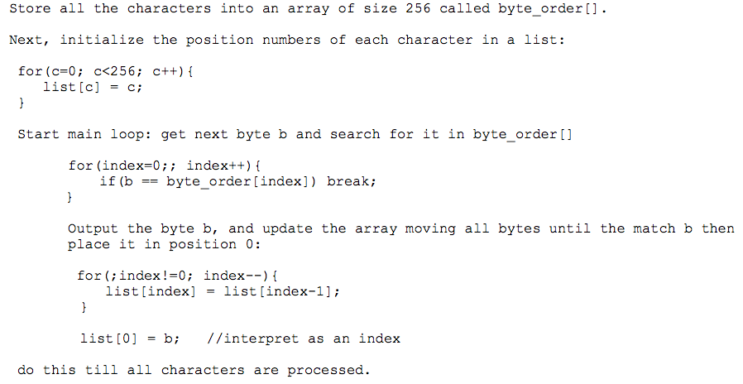
Encoding MTF

Slide 14
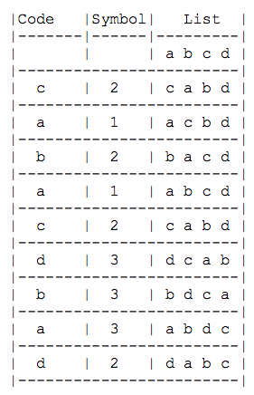
Is this process reversible?
Example: 0 1 2 3
Suppose we are processing the stream:"2 1 2 1 2 3 3 3 2" using the characters a b c d

Slide 15
Decoding
Store all the characters into an array of size 256 called byte_order[].
Next, initialize the position numbers of each character in a list:
for(c=0; c<256; c++)
list[c] = c;
Get a code from the input stream
Compute the character b = list[code]
Now update the table like the encoder does:
index = start position;
for(; index!=0; --index)
list[index] = list[index-1];
list[0] = b; //interprete as an index

Slide 16
Burrows Wheeler Encoding
The Burrows-Wheeler transform (BWT, also called block-sorting compression), is an algorithm used in data compression techniques such as bzip2. It was invented by Michael Burrows and David Wheeler in 1994.
When a character string is transformed by the BWT, none of its characters change value. The transformation permutes the order of the characters.
If the original string had several substrings that occurred often, then the transformed string will have several places where a single character is repeated multiple times in a row. This is useful for compression, since it tends to be easy to compress a string that has runs of repeated characters by techniques such as move-to-front transform and run-length encoding.

Slide 17
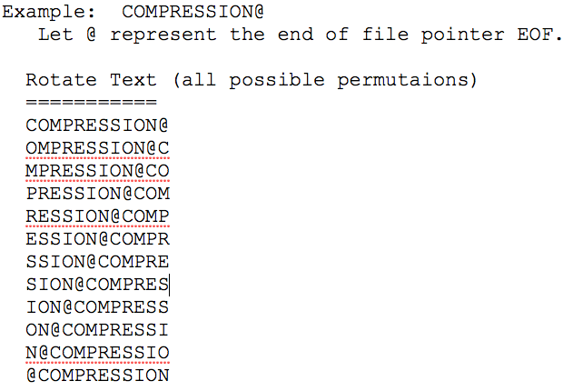
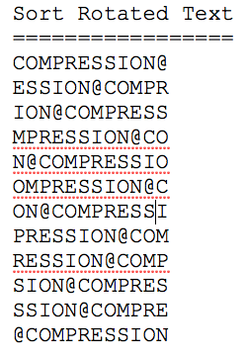

Burrows Wheeler Encoding
Burrows-Wheeler Transform algorithm of string s:
create a table, where rows are all possible rotations of the string s
sort rows alphabetically
return (last column of the table)

Slide 18
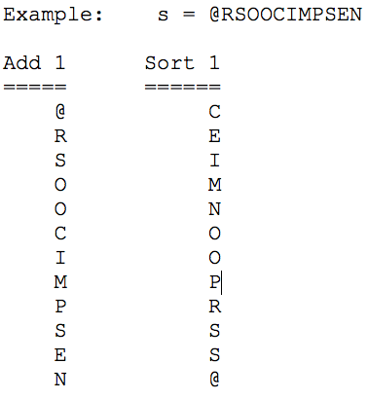











Burrows Wheeler Decoding
create empty table
repeat length(s) times
insert s as a column of table before first column of the table
sort rows of the table alphabetically
return (row that ends with the 'EOF' character)
*

Slide 19



Burrows Wheeler

Slide 20


Recovering Original

